Slide 1

Port Terminal Machine Operating Time Forecasting
Predictive Modeling of STS Crane Operations

Slide 2


Presented By: Emad Ali Emad

Slide 3
Introduction
Africa Gulf Logistics (AGL) operates two major port terminals: Abidjan Terminal Logistics (ATL) and Côte d'Ivoire Terminal (CIT).
These ports handle a wide variety of vessels, making them crucial for regional and international trade.
Ship-to-Ship cranes (STS) play a key role, and their operating time (active machine time on ships) is a critical KPI.
With increasing port traffic, forecasting operating time helps optimize logistics.

Slide 4
Problem Statement
Objectives
AGL needs a forecasting model to predict the operating time of STS cranes at its terminals.
The operating time varies with traffic, cargo type, and other factors.
The objective is to forecast operating time across days, weeks, months, and years to improve efficiency.

Slide 5
Objective
Develop a machine learning model to forecast the STS crane operating time at ATL and CIT.
Provide an API that returns forecasting graphs based on user-selected machines and time periods (days or weeks).

Slide 6
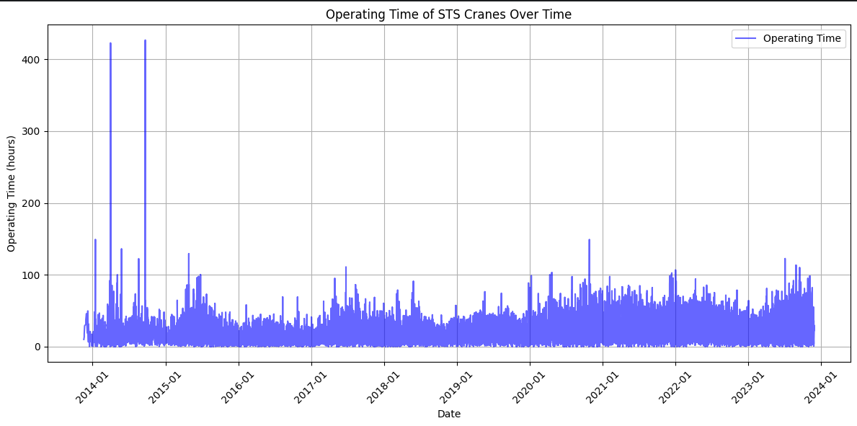
Dataset Overview
Rows: 26,978
Columns: 14 (including Operating Time, Networking Time, Equipment Details, and Date Fields)
Key Feature: Operating Time (target variable)

Slide 7
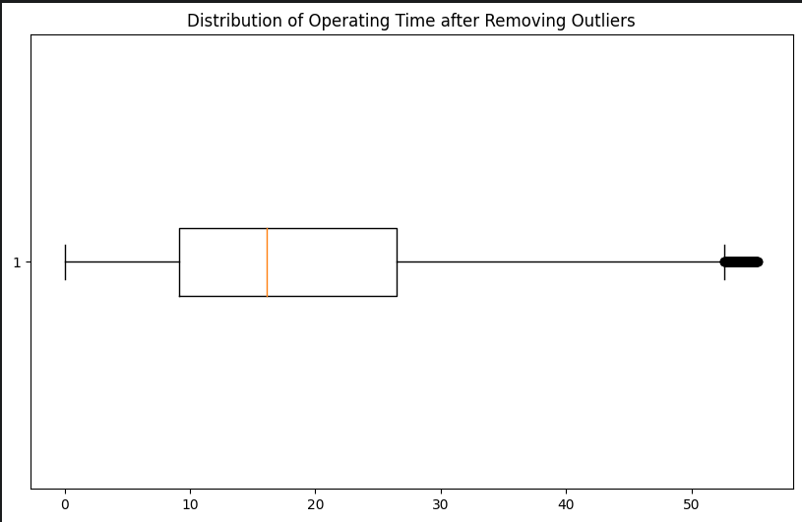
Data Preprocessing
Converted date columns to `datetime` format.
Removed outliers from 'Operating Time' using IQR method.
Normalized the features to ensure consistency in model training.
Filtered features: Focused on Networking Time, First Move Date, and Last Move Date.

Slide 8
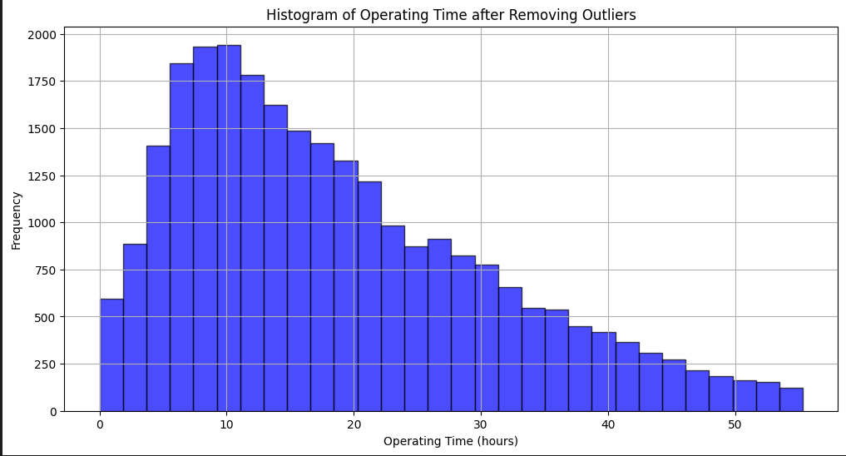
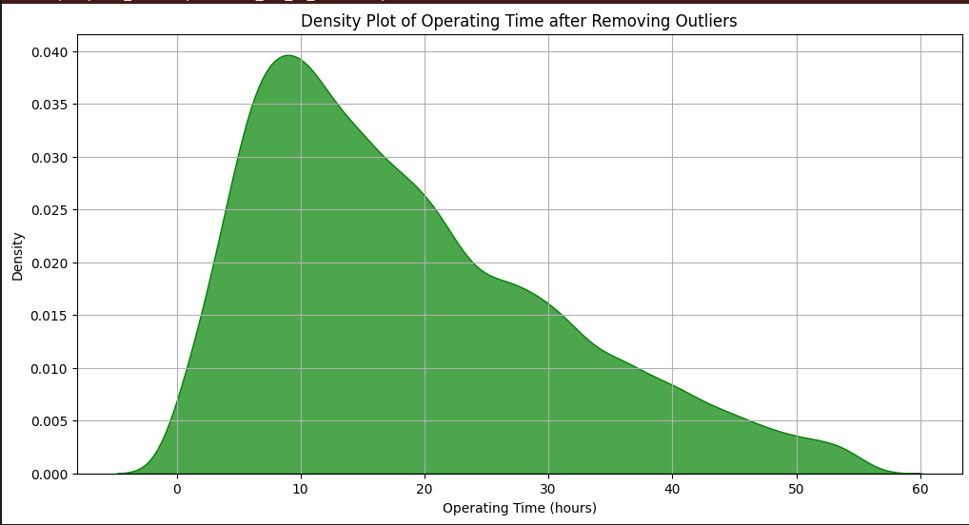
Data Visualization
Operating Time Over Time: Histogram and Density Plot to show the refined data distribution.

Slide 9
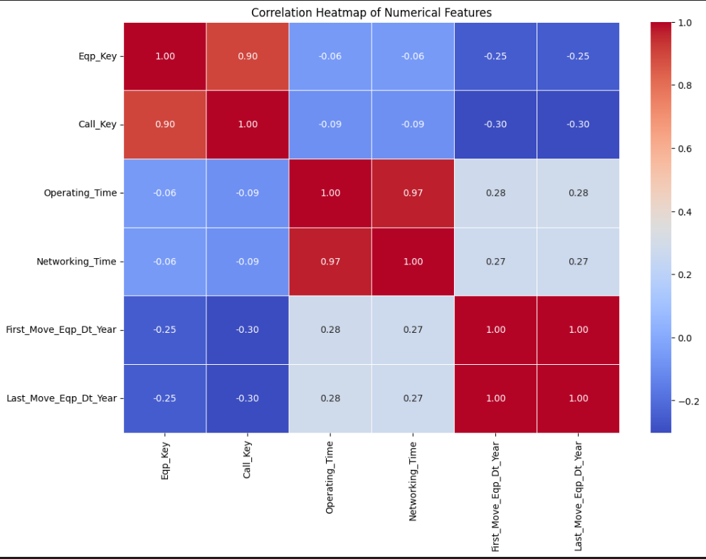
Feature Selection & Correlation:
Displaying the relationships between numeric variables.
Selected correlated features with Operating Time :
Networking Time
First Move Year
Last Move Year

Slide 10
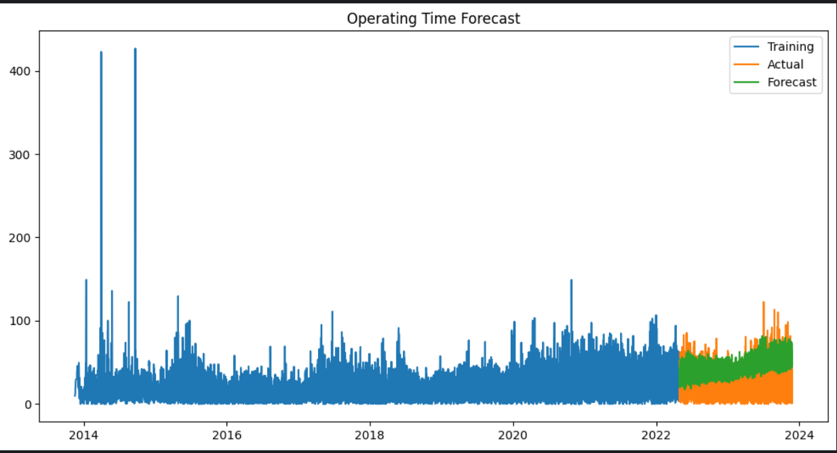
Models : SRIMAX

Slide 11

Neural Network Model (LSTM)
Model Architecture:
Input Layer: 64 neurons, ReLU activation.
Hidden Layer: 32 neurons, ReLU activation.
Output Layer: 1 neuron for predicting Operating Time.
Optimization:
Optimizer: Adam
Loss Function: Mean Squared Error
Early Stopping to prevent overfitting.

Slide 12
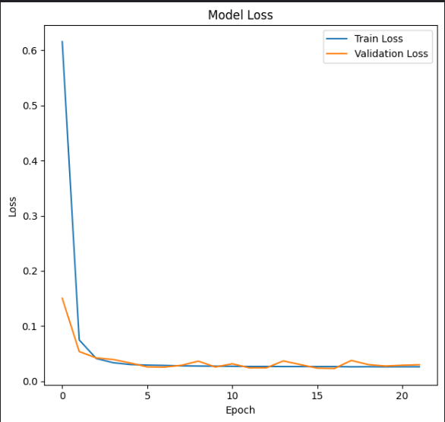
Model Performance
Training Performance Validation loss decreased steadily with early stopping after several epochs.
Test Performance: Achieved a Test Loss of 0.025 after evaluation.

Slide 13
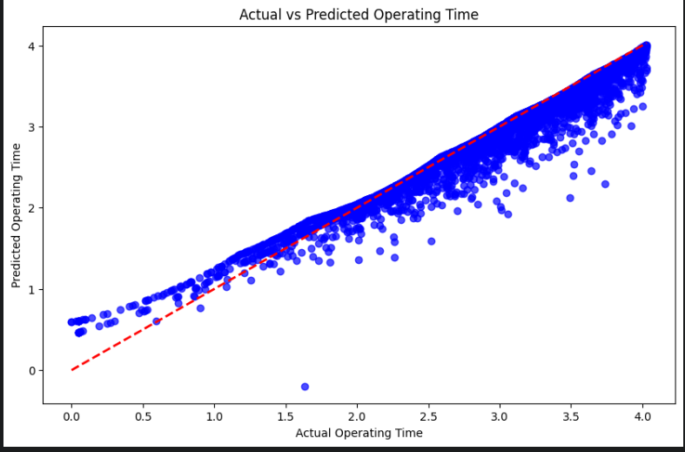
Model Performance
Residuals Analysis: Plot of residuals to confirm no pattern and a good fit.

Slide 14
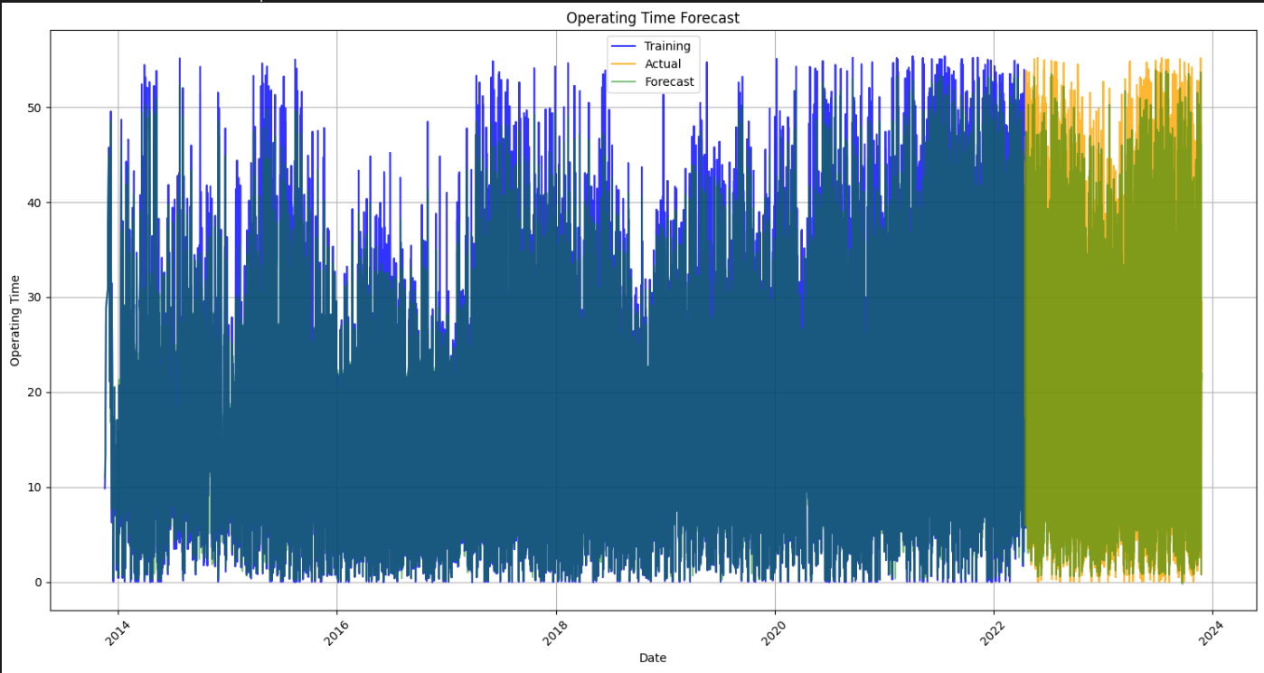
Model Prediction
Mean Absolute Error (MAE): 0.10503651538059261
R-squared (R²): 0.944108742147949

Slide 15
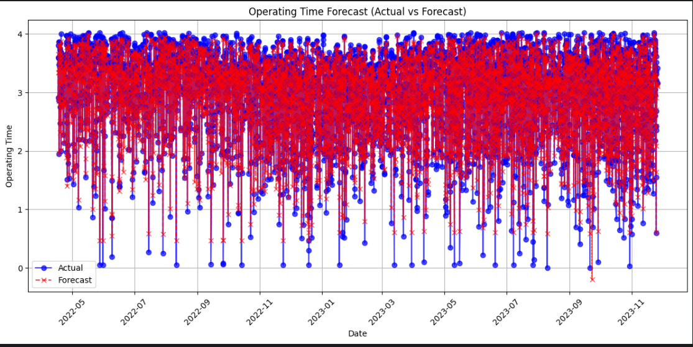

Slide 16
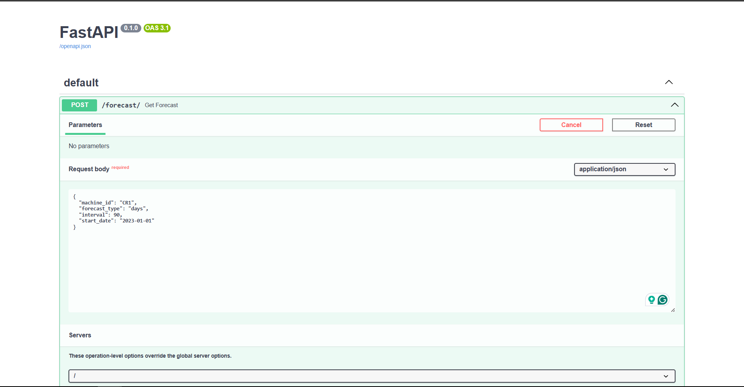
Deployment Using FastAPI
API will return operating time predictions and visualizations for selected machines.

Slide 17
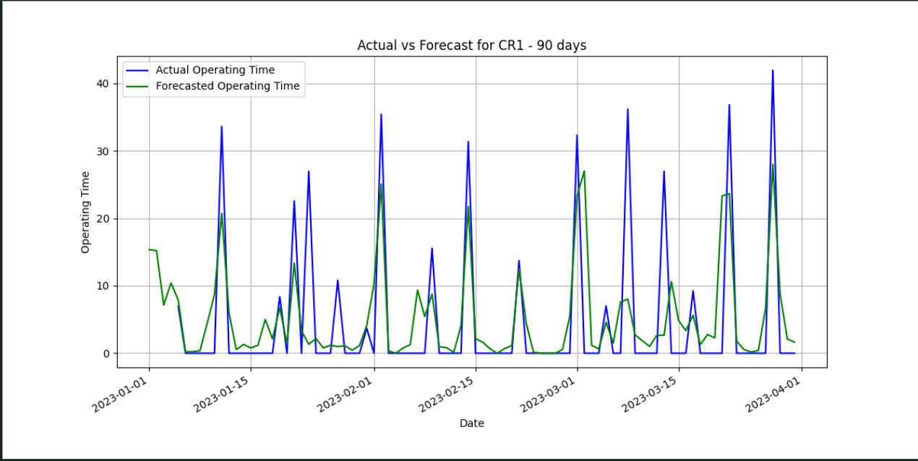
The result

Slide 18
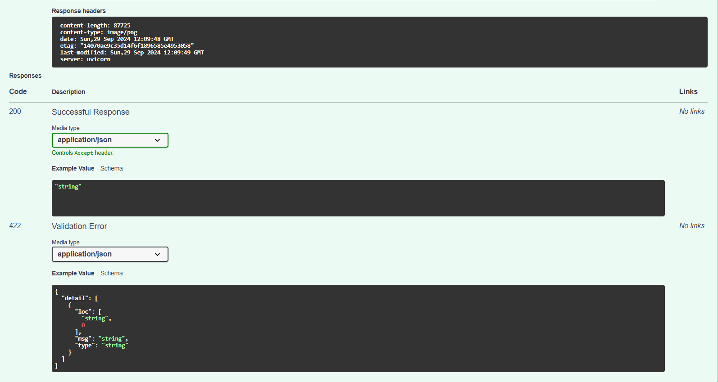

Slide 19
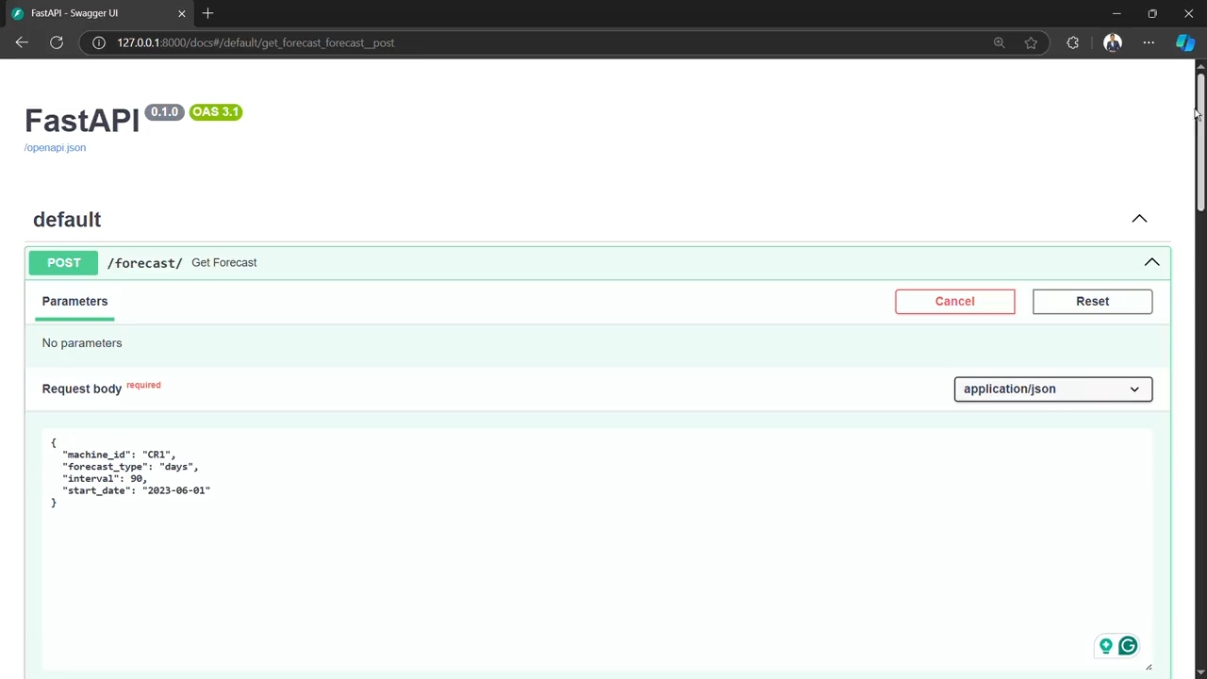
Video

Slide 20

Thanks

